Slide 1
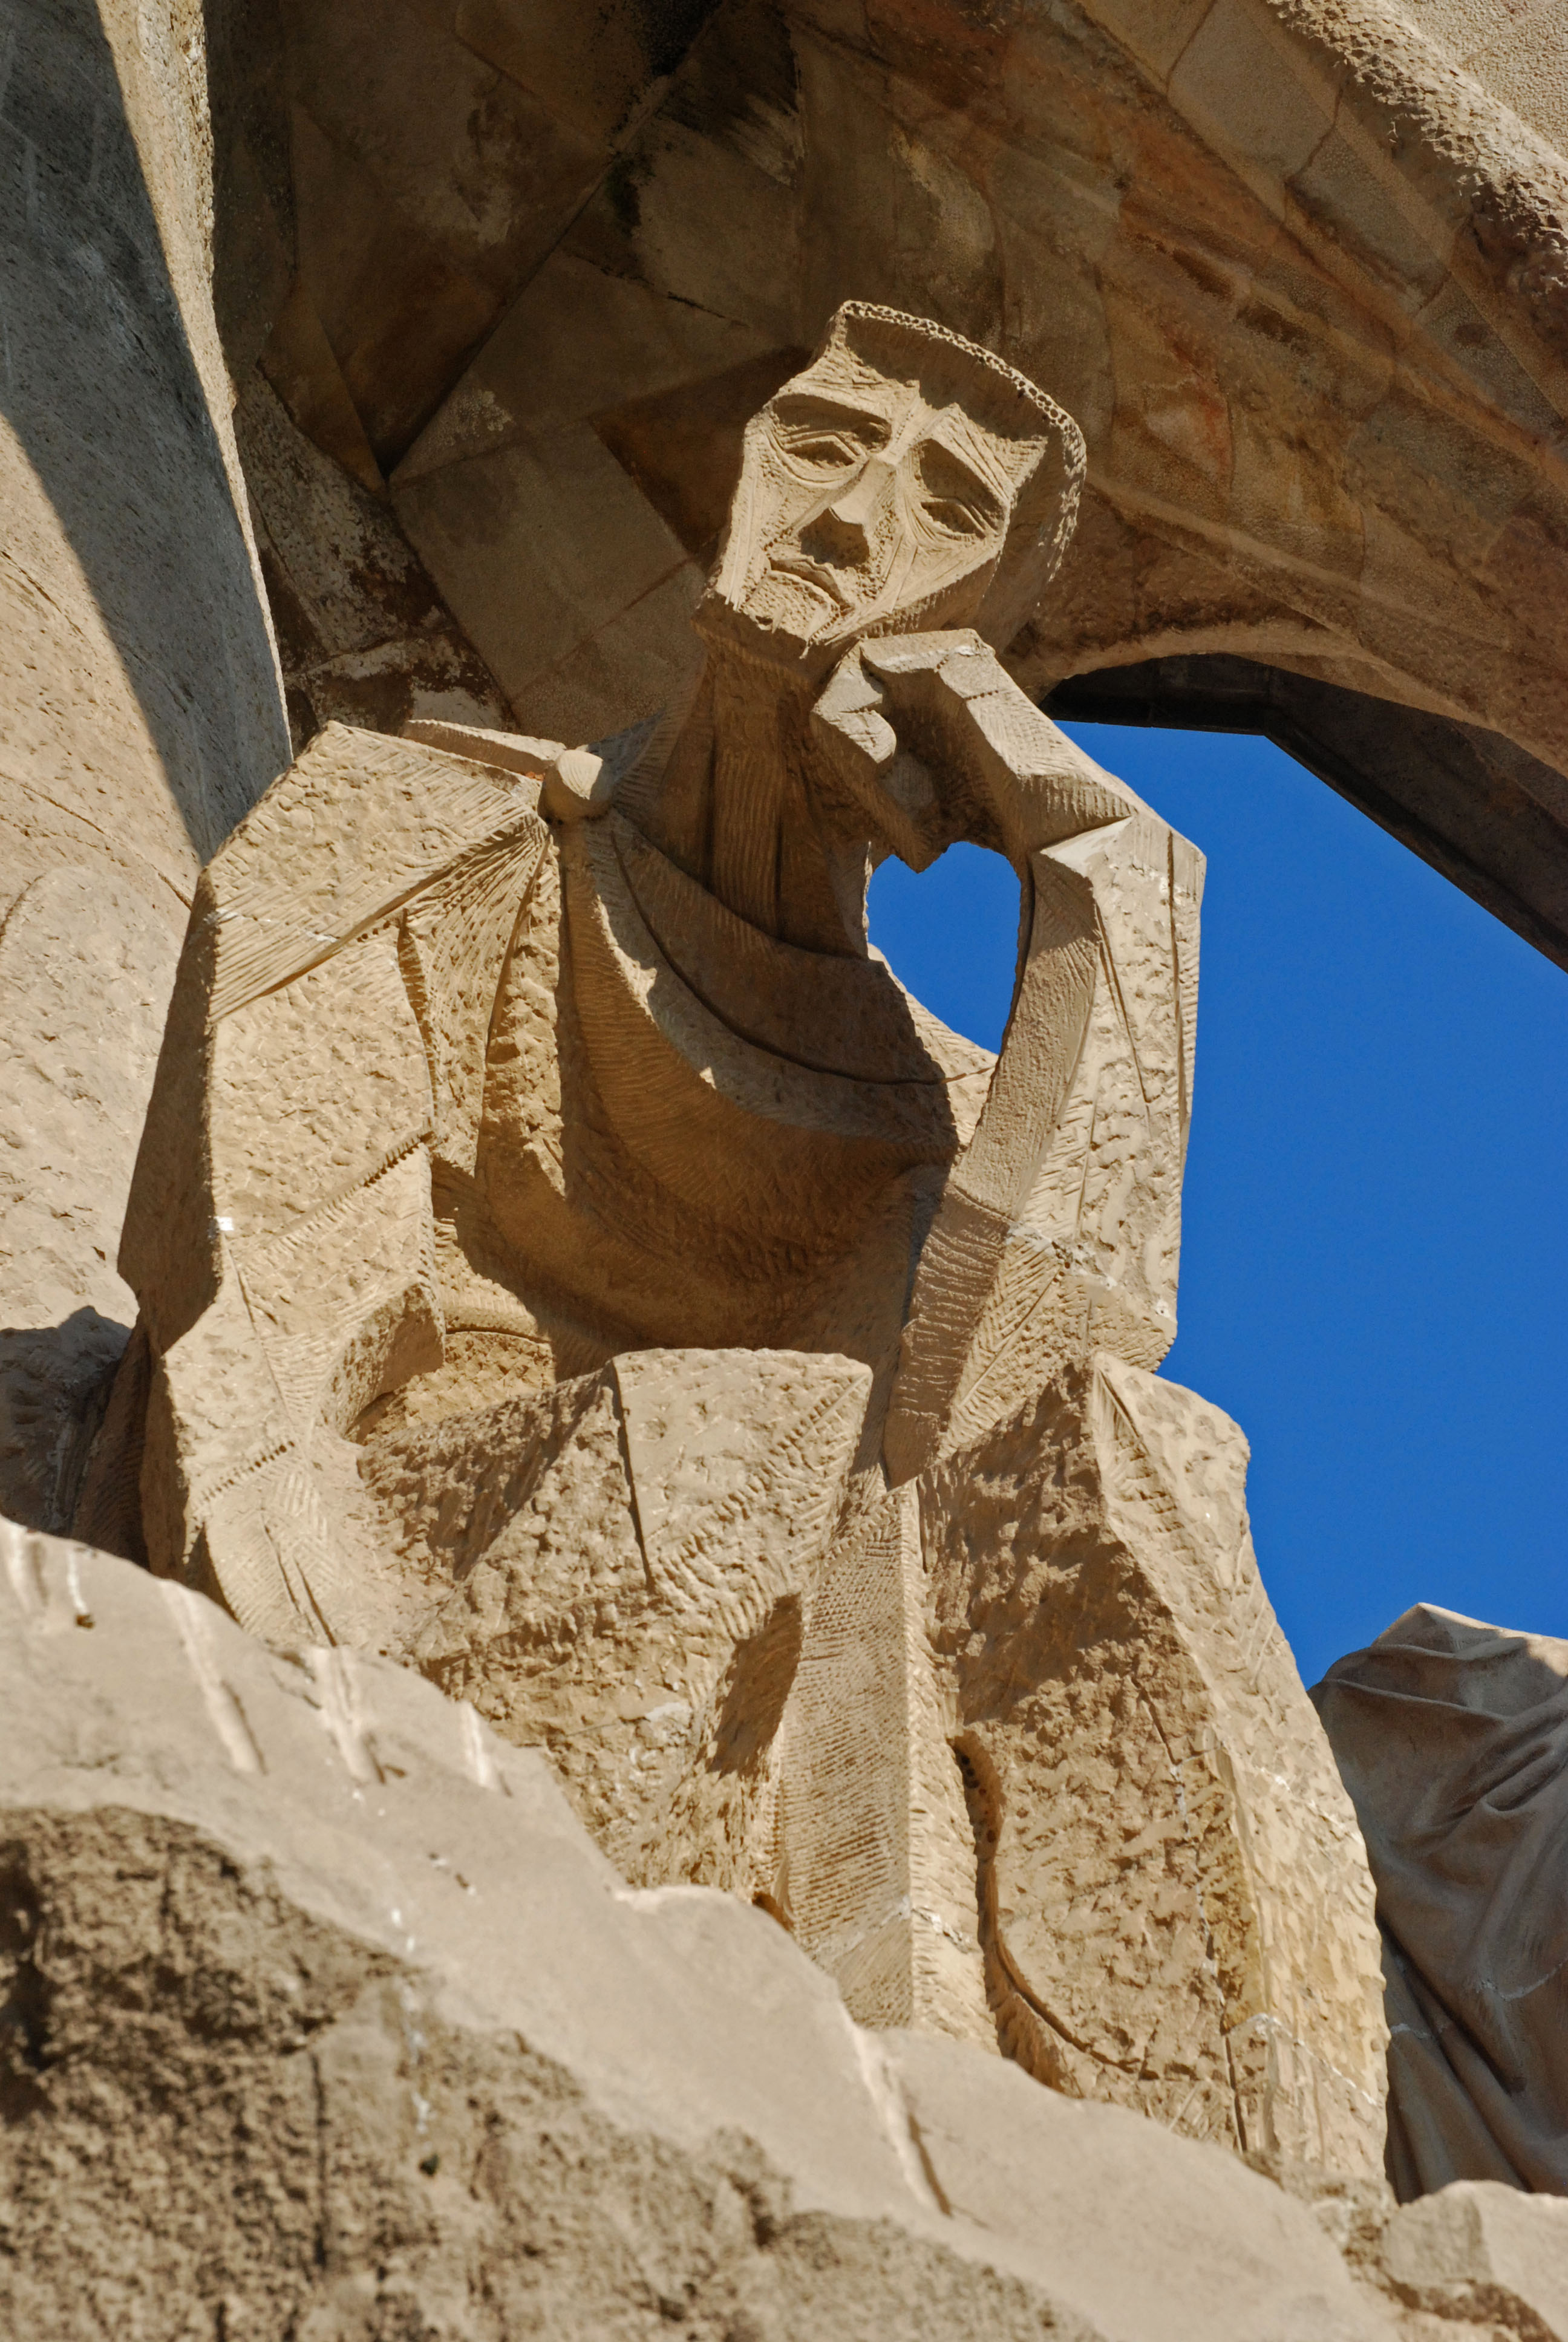
Architectures of Intelligence Lecture 4 Modularity & fMRI

Slide 2
Today
Using fMRI to evaluate ACT-R models
ROI analysis
Checking modularity with fMRI
What is a good model?

Slide 3
Manual
Control
Visual
Perception
Production
System
Declarative
Memory
Problem State
ACT-R
Control
State
simulates cognition
implements cognition

Slide 4
Manual
Control
Visual
Perception
Production
System
Declarative
Memory
Problem State
ACT-R
Control
State
simulates cognition
cognition
implements cognition
Notes:
Hwo are the two related?

Slide 5
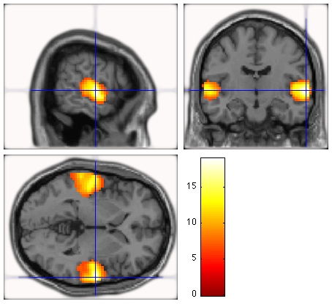
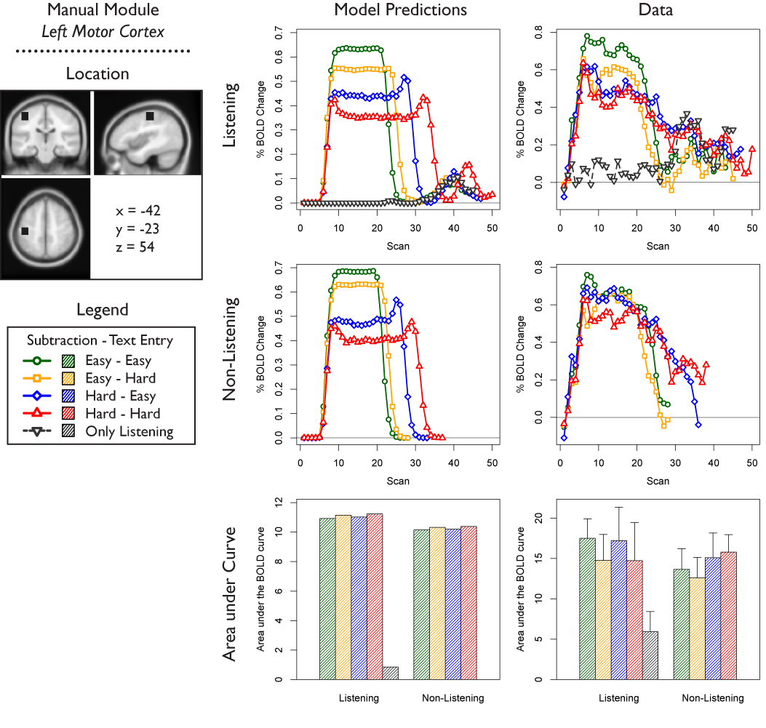
Why fMRI & ACT-R?
Model-based fMRI analysis
Region-Of-Interest analysis
locating (modeled) brain functions
constraining models
=> understanding the brain
=> evaluating cognitive models
Notes:
Location is interesting, but not now. Will briefly come back to it during the ‘practical part’.

Slide 6
Constraining Models
ACT-R Model
RT
RT
RT
RT
RT
RT
RT
How can we deal with this complexity?
Predict data
Use neuroimaging data
Predict neuroimaging data

Slide 7
ROI Analysis
constraining models

Slide 8
Motor Cortex
ACT-R
Posterior Parietal
Anterior Cingulate
M
V
M
manual control
Manual
Control
Visual
Perception
V
visual perception
Fusiform
LIPFC
Striatum
R
Production
System
declarative memory
Declarative
Memory
Imaginal
I
imaginal
I
R
G
Control
State
control state
G
production system
Notes:
Implement the threaded cognition theory as a computational model

Slide 9
Goal

Slide 10
Goal

Slide 11
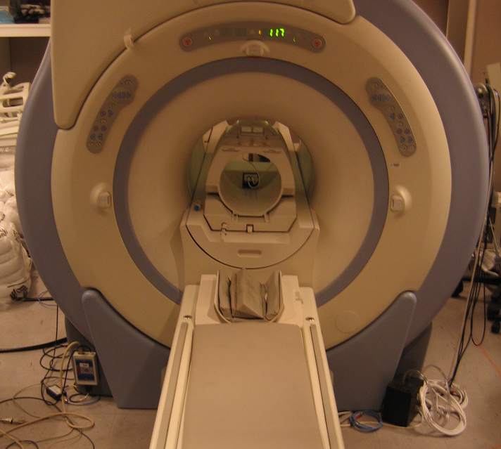


Slide 12
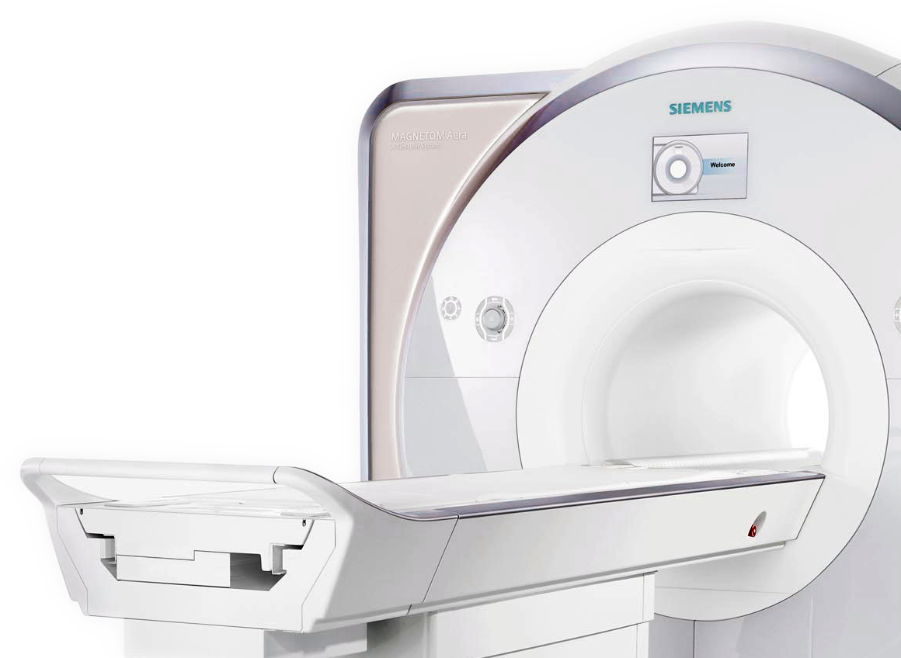
fMRI
In very short:
Neural activity
Increase of oxygenated blood
Oxygenated blood has different magnetic properties
fMRI scanner measures magnetic properties

Slide 13
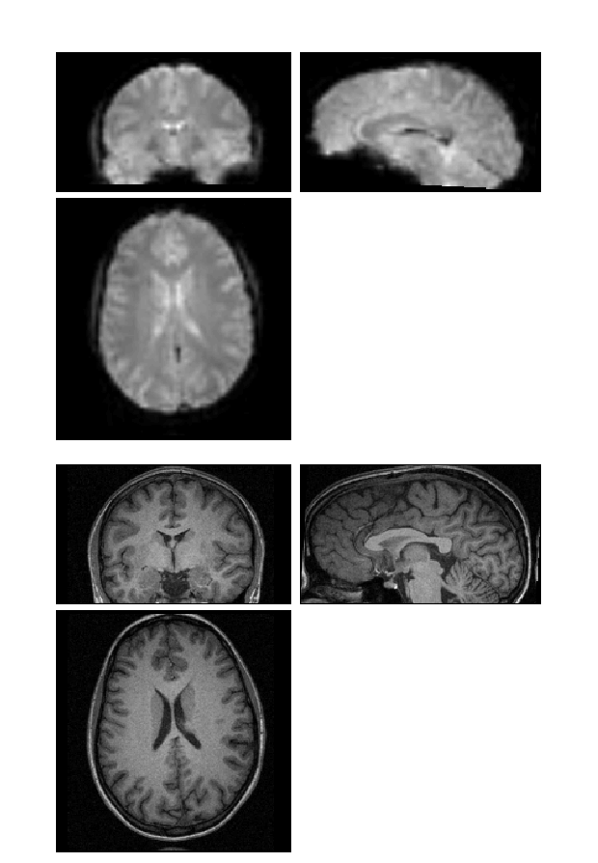
fMRI data
Structural / T1
Functional / T2*
1 volume per participant
4000 volumes per participant

Slide 14
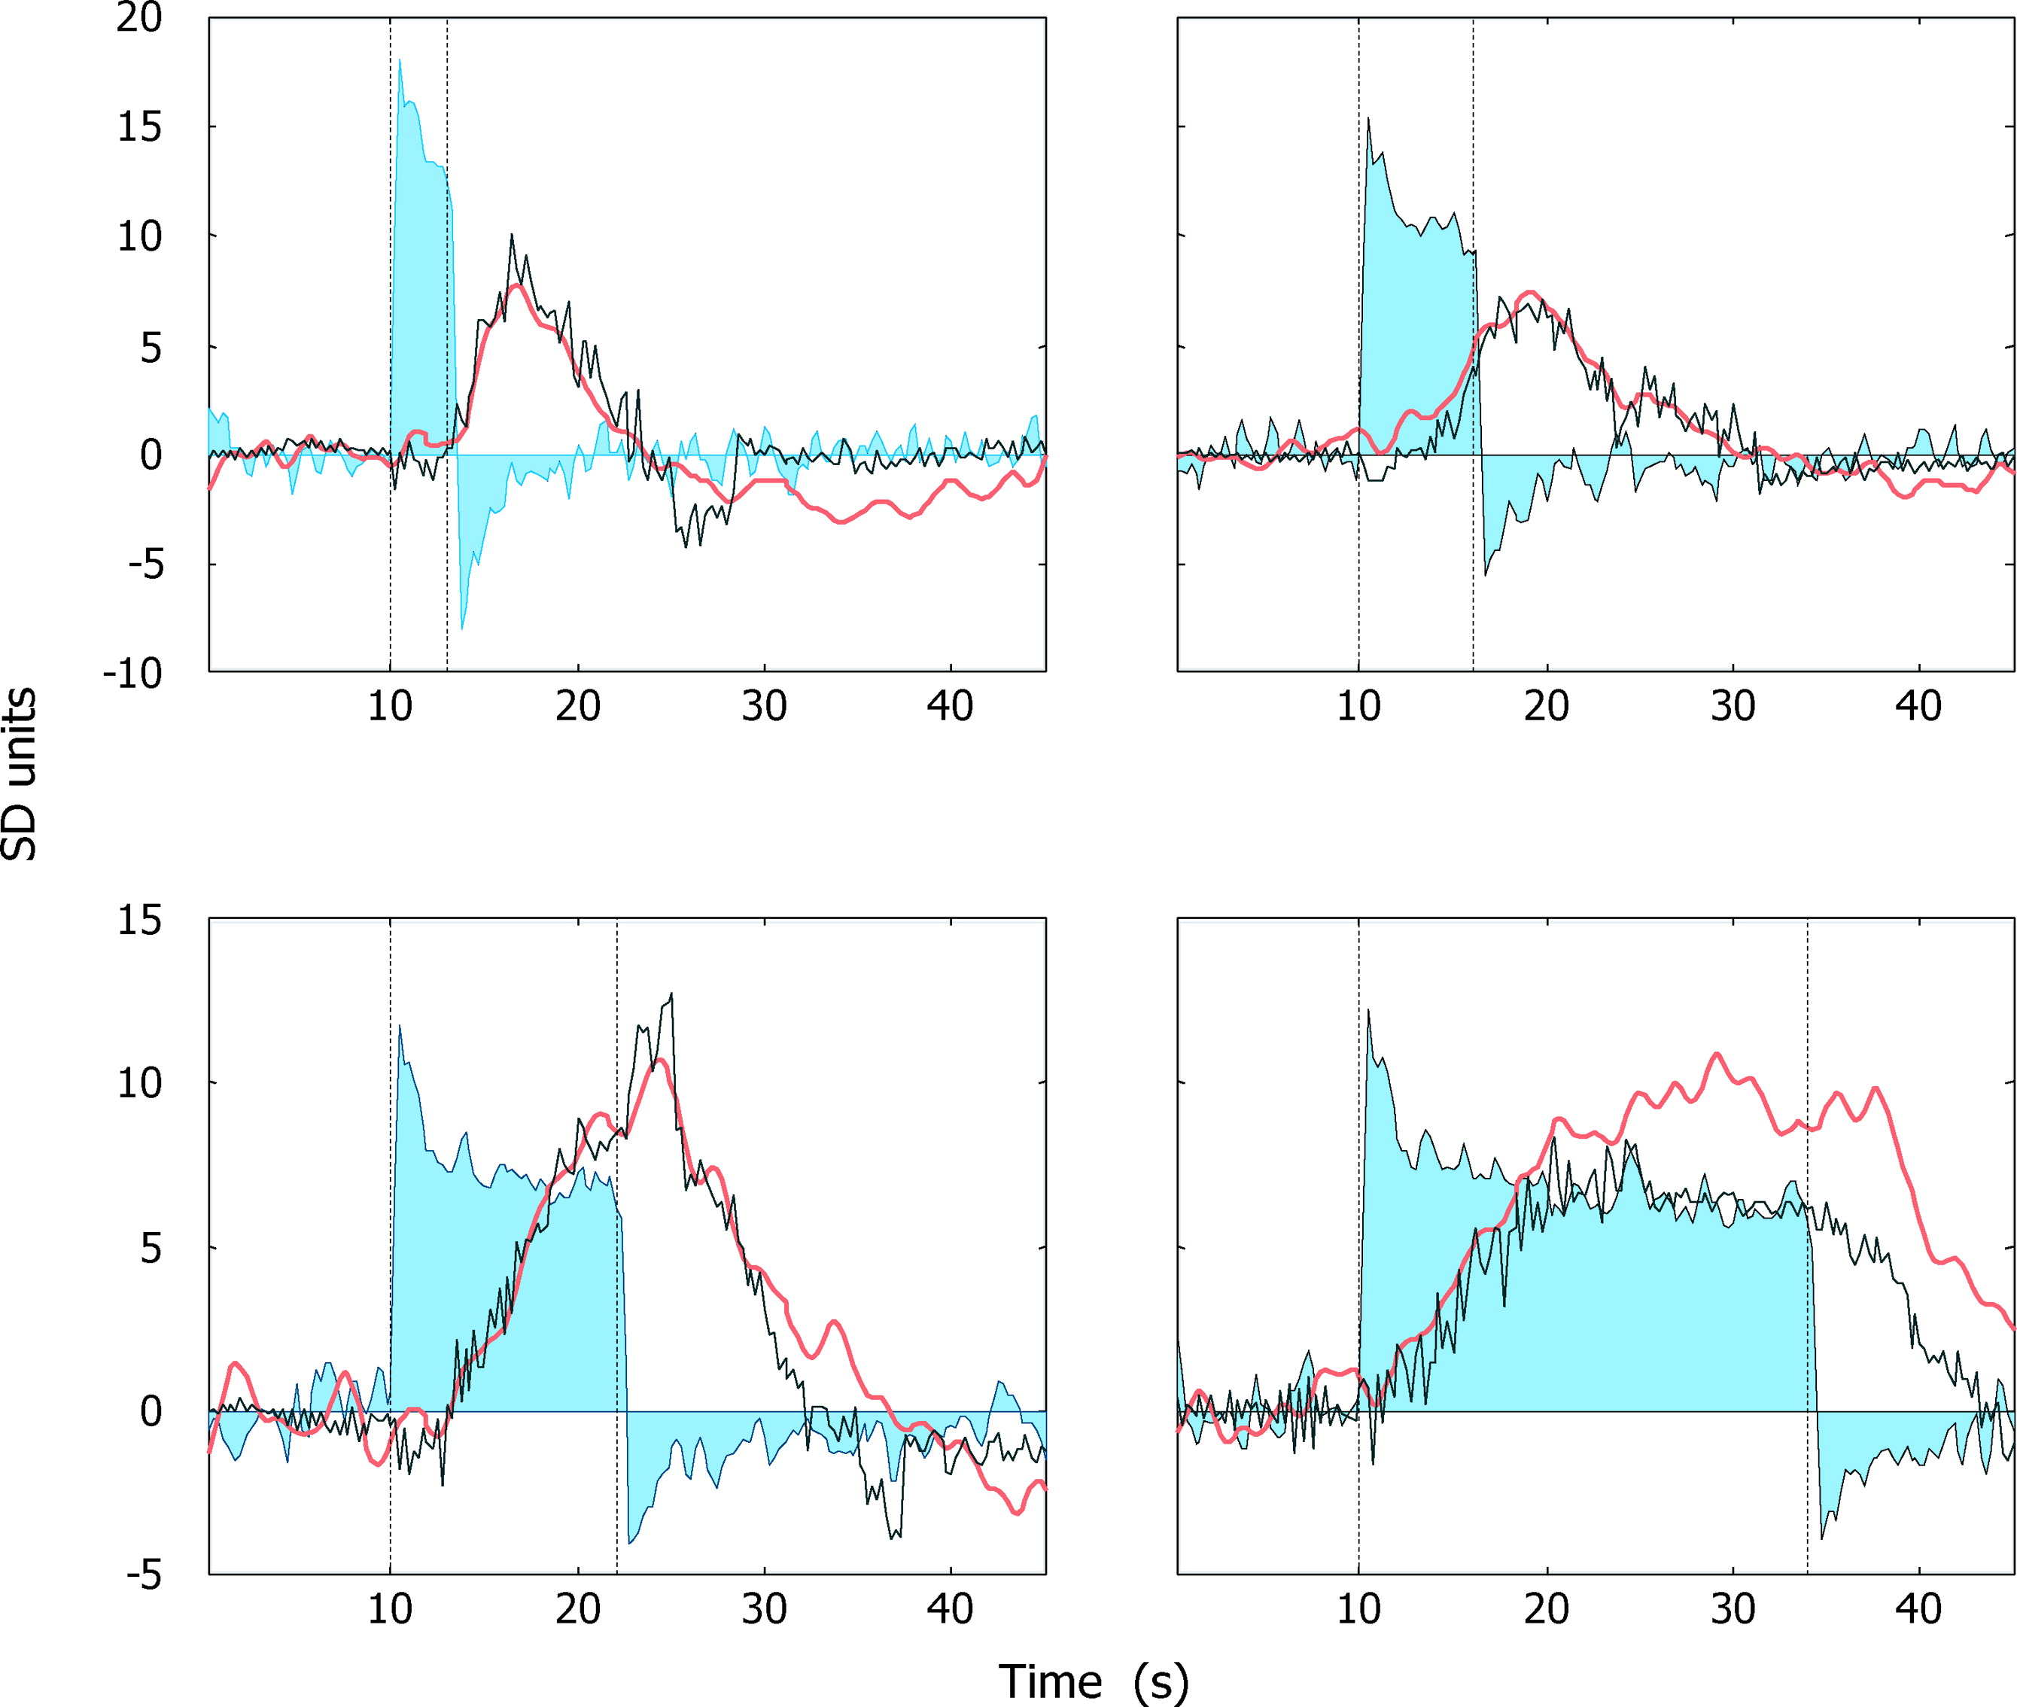
BOLD response
local field potentials
observed BOLD response
Logothetis & Wandell 2004, Ann. Rev. Physiol.

Slide 15
Hemodynamic Response Function

Slide 16
Goal

Slide 17
?

Slide 18
Goal

Slide 19
BOLD response
local field potentials
observed BOLD response
Logothetis & Wandell 2004, Ann. Rev. Physiol.

Slide 20
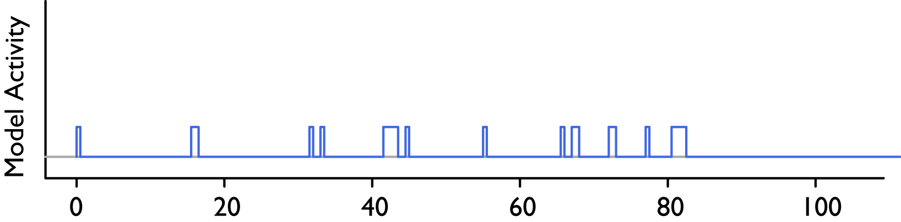

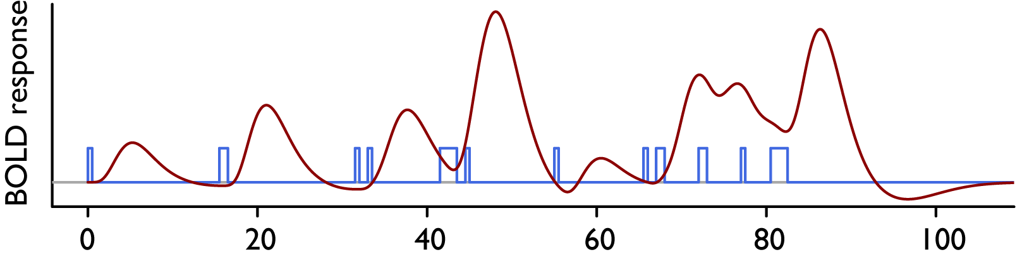
Convolution
H(t)
D(t)

Slide 21
Finally…

Slide 22
Exam

Slide 23
5 $ 3 = ?
5 $ 3 = 5 + 4 + 3 = 12
Notes:
36 repetitions

Slide 24
Exam

Slide 25
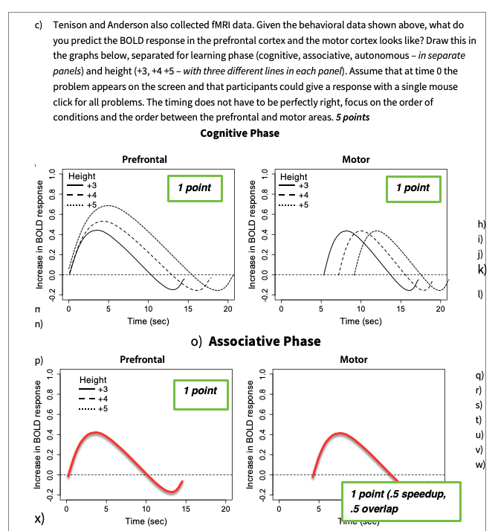
Exam

Slide 26
?

Slide 27
Today
Using fMRI to evaluate ACT-R models
ROI analysis
Checking modularity with fMRI
What is a good model?

Slide 28
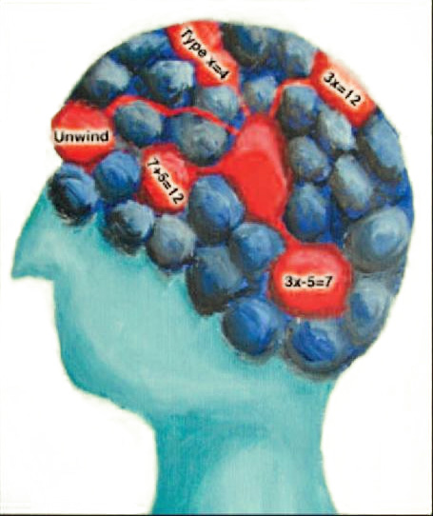
Checking modularity with fMRI
Notes:
So what about this brain evidence I was talking about?

Slide 29
Anderson et al., 2007; Chapter 2
If the brain is modular:
we should be able to switch modules on and off individually
find the effects in the right Regions-of-Interest
and simulate the results with a model

Slide 30
Experimental Setup: Names Task

Slide 31
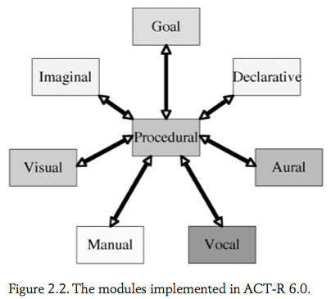
Feedback: Visual or Aural
Dick
?
0.5 sec
Fred
Substitution:
Yes (AT/BE) or No (14/23)
0.5 sec
Tom
0.5 sec
Knowledge: AT→14 BE →23
say name 3
< 1 sec
say name 2
< 1 sec
Output: Vocal or Manual
Transformation:
Yes (23) or No (14)
say name 1
< 1 sec
press key
Instruction:
23
Delay:
Yes or No
< 10.5 sec
DELAY
0 or 4 sec
Fred
0.5 sec
Dick
0.5 sec
Tom
Input: Visual or Aural
0.5 sec
*
1.5 sec

Slide 32
*

Slide 33
Tom

Slide 34
Dick

Slide 35
Fred

Slide 36
13

Slide 38
Fred

Slide 39
Dick

Slide 40
Tom

Slide 41
Which condition was this?
Input?
Visual
Output?
Vocal
Transformation?
Yes
Substitution?
No
Delay?
No

Slide 42
*

Slide 43

Notes:
Tom

Slide 44
Notes:
Dick

Slide 45
Notes:
Fred

Slide 47
BE

Slide 50
Notes:
Fred

Slide 52
Which condition was this?
Input?
Aural
Output?
Vocal
Transformation?
Yes
Substitution?
Yes
Delay?
Yes

Slide 53

Some Behavioral Results
visual input and vocal output
No delay
Delay
Instruction:
14
23
AT
BE

Slide 54
Some Behavioral Results
visual input and vocal output
No delay
Delay
Instruction:
14
23
AT
BE
Notes:
What is interesting here? The effects are the same size: same difficulty!

Slide 55
Aural-Manual
Visual-Manual
No delay
Aural-Vocal
Visual-Vocal
Delay

Slide 56
Anderson et al., 2007; Chapter 2
If the brain is modular:
we should be able to switch modules on and off individually
find the effects in the right Regions-of-Interest
and simulate the results with a model

Slide 57
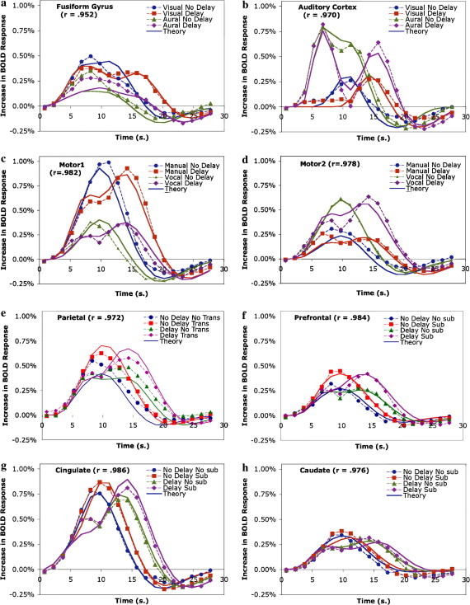
Visual
Aural
Notes:
Arual no delay, aural dealy: one bump is presentation, one feedback
Visual, what are these bumps?

Slide 58
Aural Details

Slide 59
Visual
Aural
Manual
Vocal
Notes:
Arual no delay, aural dealy: one bump is presentation, one feedback
Visual, what are these bumps?
Instruction was always visual.

Slide 60
Imaginal
Retrieval
Why are these results not ‘clean’?

Slide 61
?

Slide 62
Anderson et al., 2007; Chapter 2
If the brain is modular:
we should be able to switch modules on and off individually
find the effects in the right Regions-of-Interest
and simulate the results with a model

Slide 63
Model
Dick
Fred
if transformation, retrieve names and transform via imaginal buffer
Tom
perceive feedback
say name 3
say name 2
output responses
if letters, retrieve corresponding numbers from declarative memory
say name 1
press key
rehearse responses
23
read instruction
DELAY
Fred
if delay, rehearse names once
Dick
Tom
perceive names and store with position via imaginal in declarative memory

Slide 64
Some Model Fits
visual input and vocal output
No delay
Delay
Instruction:
14
23
AT
BE

Slide 65
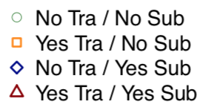
Model predictions for Aural
Aural input and manual output
Delay
With Delay
The model hears the names
The model hears the feedback
Delay
Why are the curves shifted after the delay?

Slide 66
Model predictions for Aural
Aural Input
Visual Input
No Delay
Delay
No Delay
Delay
Manual Output
Vocal Output

Slide 67
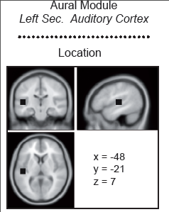
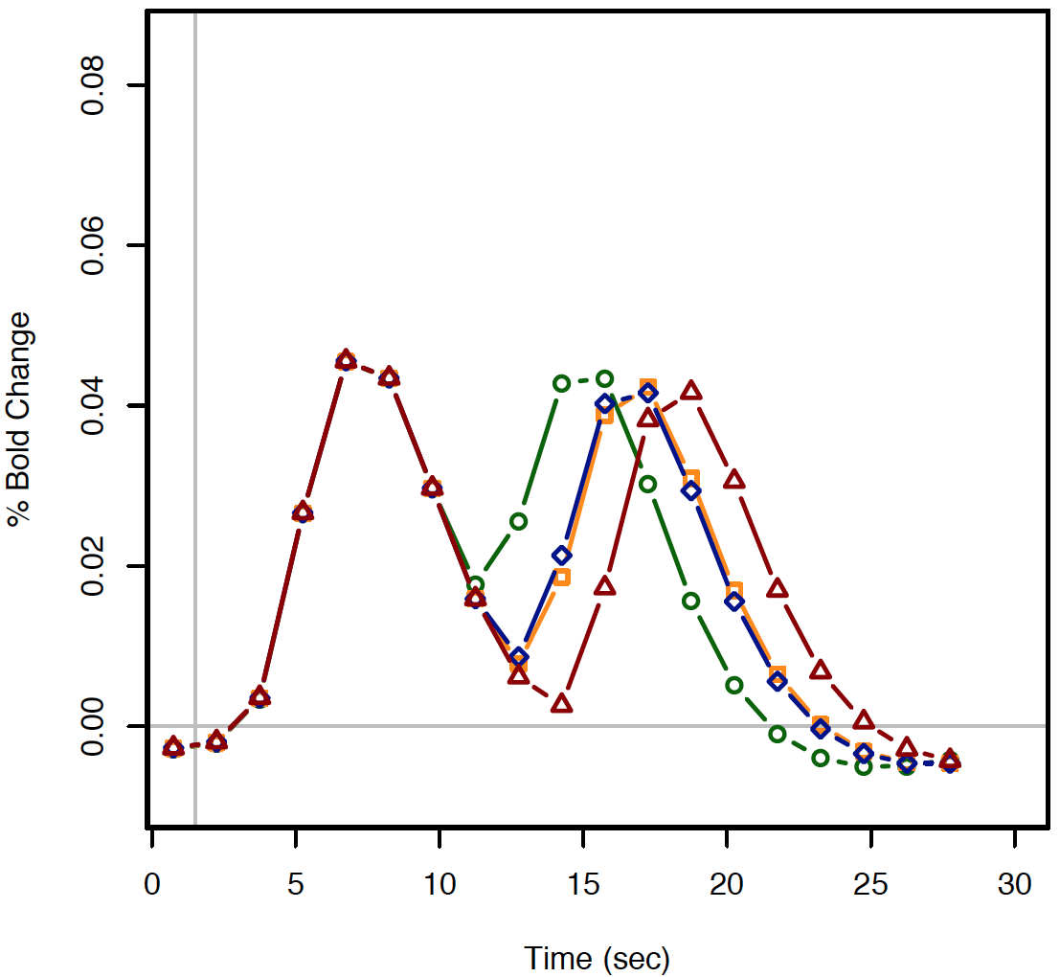
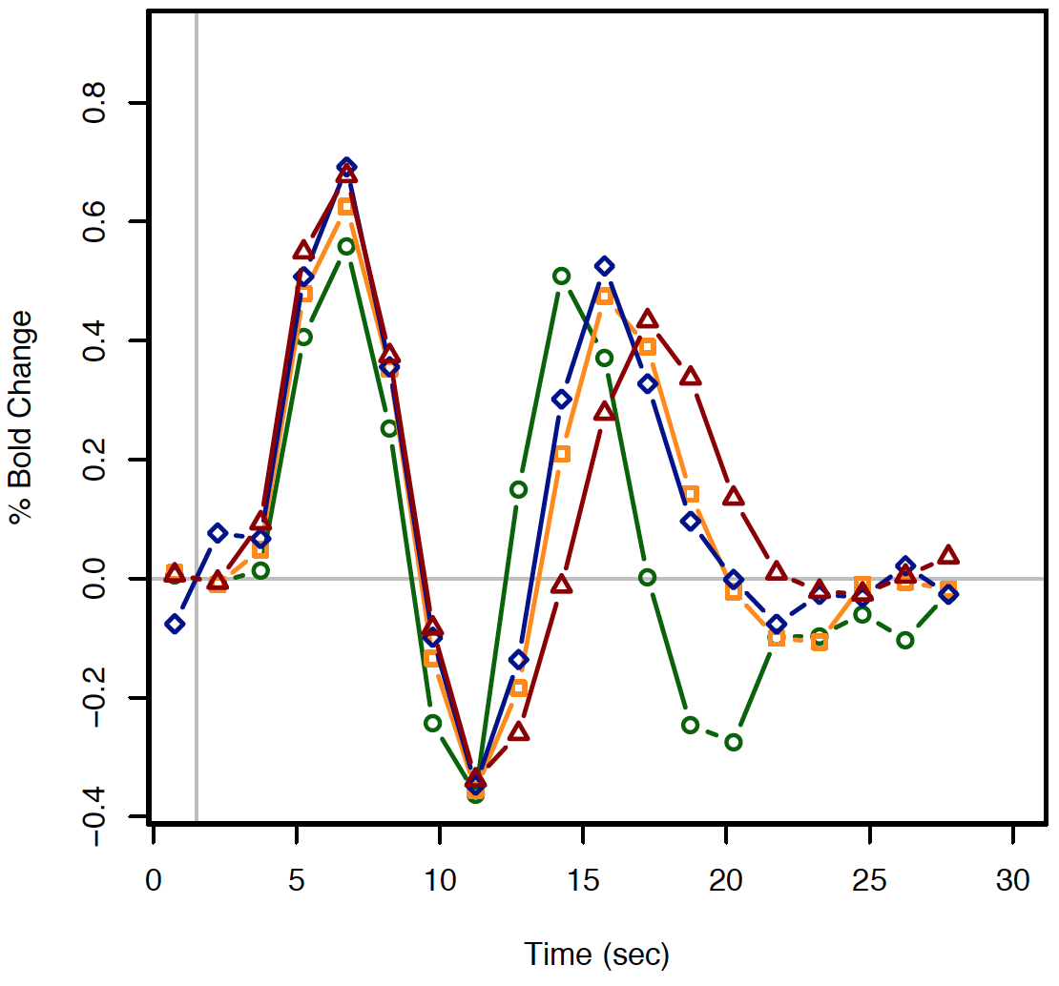
ROI analysis – Aural Module
aural input and manual output
Model Prediction
Human Data
Hears the names
Hears the feedback
Delay

Slide 68
Visual
Aural
Manual
Vocal
Notes:
Arual no delay, aural dealy: one bump is presentation, one feedback
Visual, what are these bumps?
Instruction was always visual.

Slide 69
Imaginal
Retrieval

Slide 70
Anderson et al., 2007; Chapter 2
If the brain is modular:
we should be able to switch modules on and off individually
find the effects in the right Regions-of-Interest
and simulate the results with a model

Slide 71
?

Slide 72
Today
Using fMRI to evaluate ACT-R models
ROI analysis
Checking modularity with fMRI
What is a good model?

Slide 73
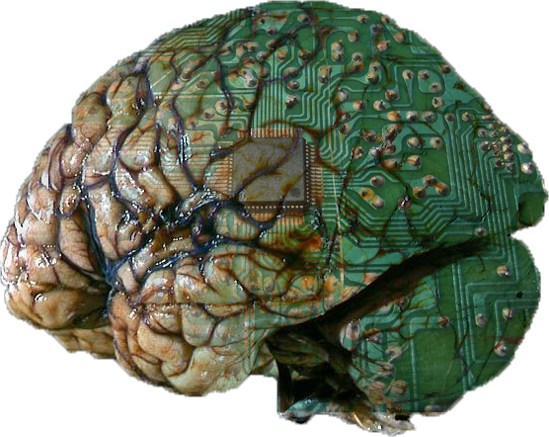
Model-Based fMRI Analysis
=> understanding the brain

Slide 74
Why the brain/fMRI?
Model-based fMRI analysis
ROI analysis
locating (modeled) brain functions
constraining models
=> understanding the brain
=> evaluating cognitive models
Notes:
Location is interesting, but not now. Will briefly come back to it during the ‘practical part’.

Slide 75
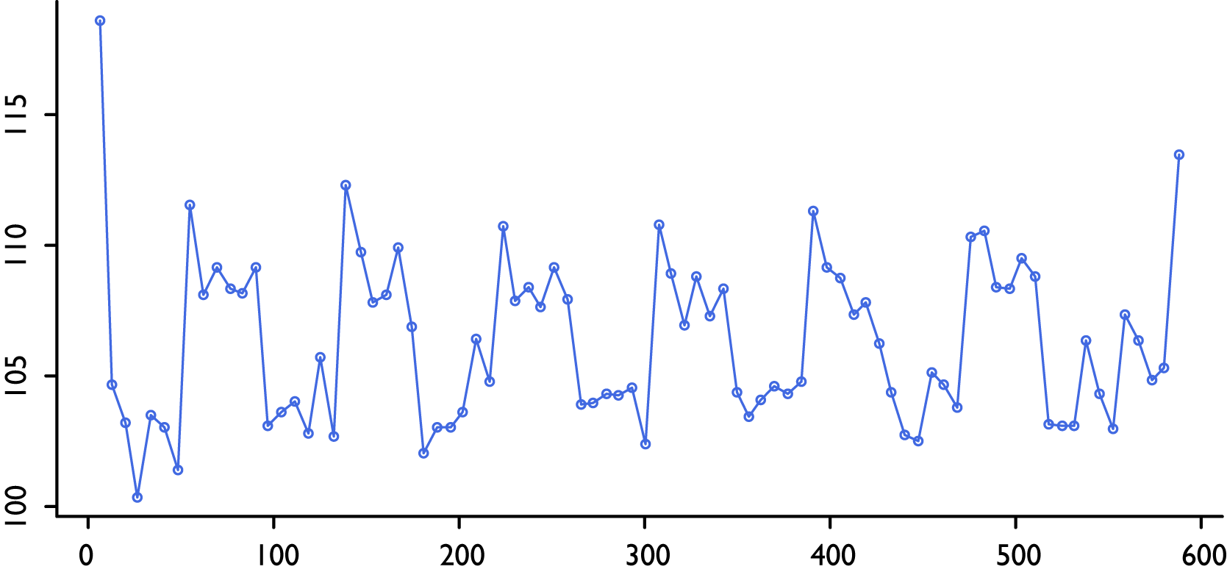
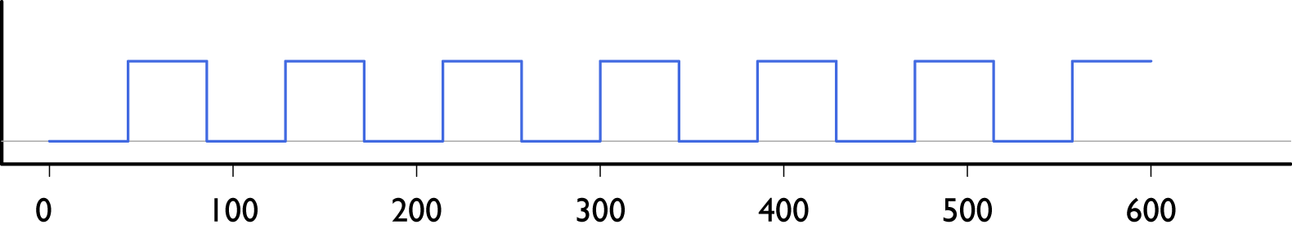
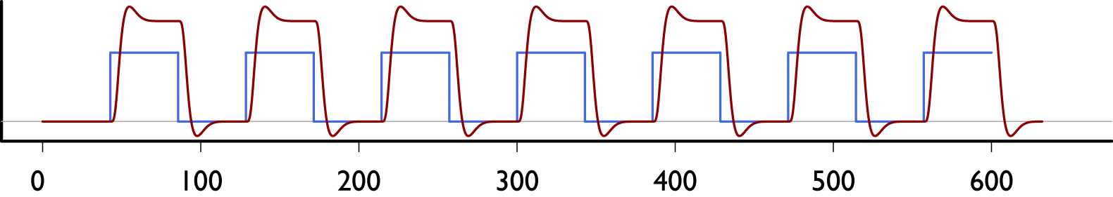
Classical fMRI analysis
BOLD response in an aural voxel
stimulus function: sound (on/off)
HRF
Notes:
en vertel nog evne dat het een auditieve taak is
is there a significant relation between the two
do this for every voxel

Slide 76

Classical fMRI analysis
BOLD response
stimulus function
linear model per voxel
which voxels correspond to the stimulus function?

Slide 77
Model-Based Analysis
BOLD response
stimulus function
[model predictions]
linear model per voxel
which voxels correspond to the stimulus function?
stimulus function?
model predictions?

Slide 78
Model Predictions
Notes:
module activity is instantaneous, like neural activity.

Slide 79
Model-Based Analysis
BOLD response
[model predictions]
linear model per voxel
which voxels correspond to the stimulus function?
model predictions?
Notes:
for all modules! now first problem state module
.

Slide 80
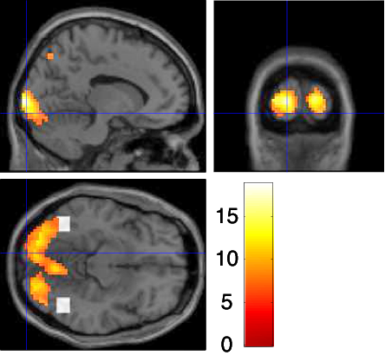
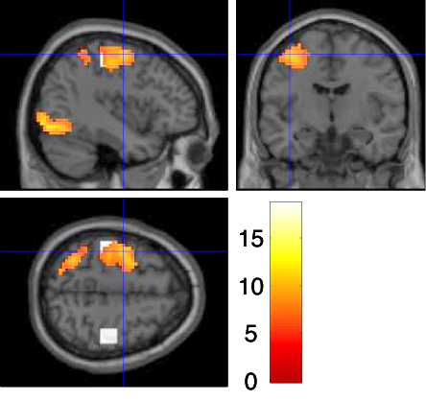
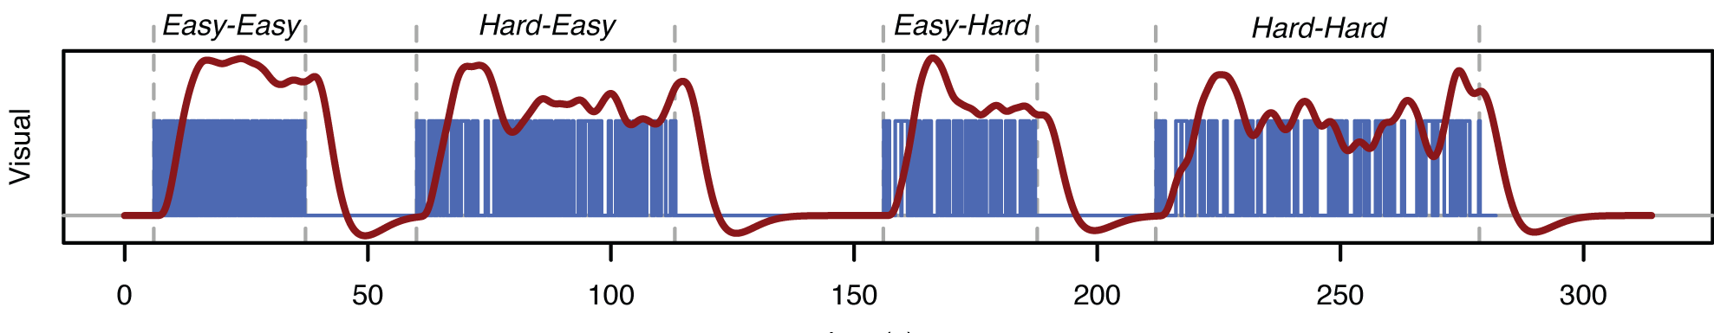
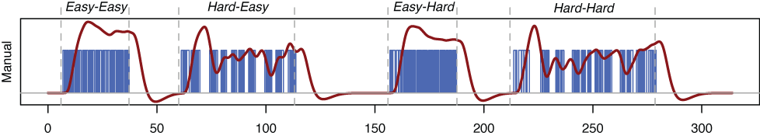
Visual
Manual
(Borst et al. 2011, NeuroImage)

Slide 81
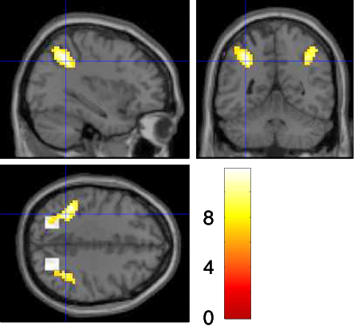
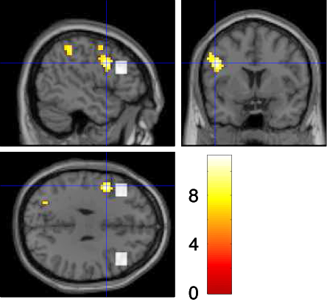
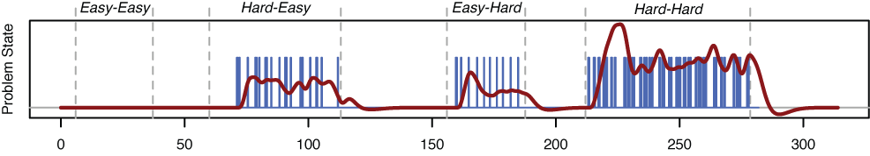
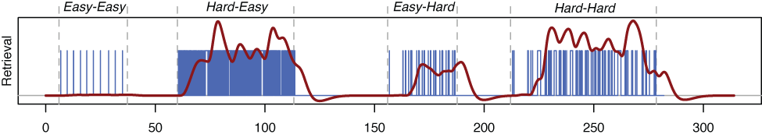
Problem State
Declarative Memory
(Borst et al. 2011, NeuroImage)

Slide 82
Compared to standard methods
Model-based Analysis
(Borst et al. 2011, NeuroImage)

Slide 83
Testing the ACT-R Brain Mapping
Five existing ACT-R models + fMRI datasets
Meta-analysis of model-based fMRI analyses (Borst & Anderson, PNAS, 2013)

Slide 84
Results
Notes:
follows anatomy!

Slide 85
Summary
Region-of-interest analysis
Neural data => models
Goal: constrain and improve models
Depends on: fixed mapping of model resources to brain regions
Model-based fMRI analysis
Models => neural data
Goal: located theorized/modeled brain functions
Depends on: quality of model

Slide 86
?

Slide 87
Today
Using fMRI to evaluate ACT-R models
ROI analysis
Checking modularity with fMRI
Using ACT-R to analyze fMRI data
Model-based analysis
What is a good model?

Slide 88
What is a good model?

Slide 89
Lecture 2: What makes a good model?
Functional criteria
The model has to be able to show intelligent behavior appropriate for the task
Behavioral criteria
The model has to perform the task in the same way as humans
Neurophysiological criteria
The model has to be faithful to what happens in the brain
Use of neural networks or neural representations
Be able to predict brain activation

Slide 90

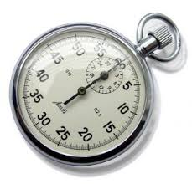
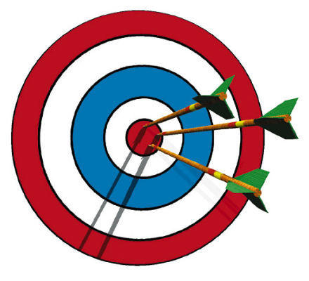
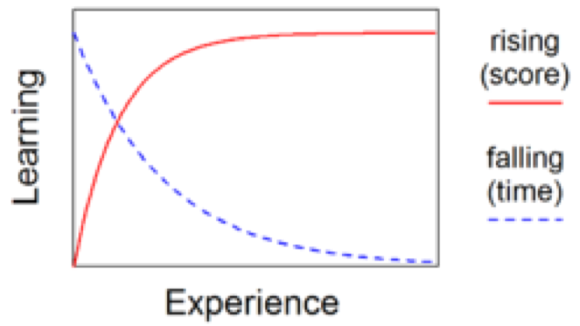

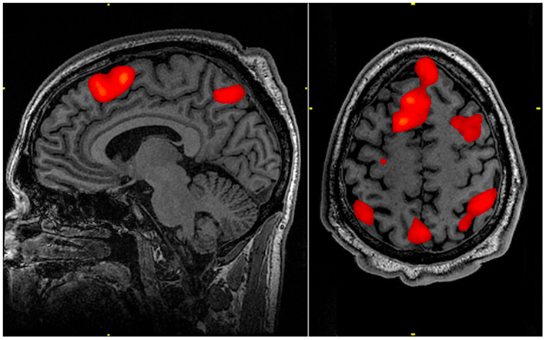
Lecture 1: Testable predictions of human behavior
Predictions should be as fine-grained as possible:
Notes:
reaction times
Accuracy/errors
choices
learning curves
eye movements
fMRI data
Mimic actual human behavior
Model and participant interact with same interface

Slide 91
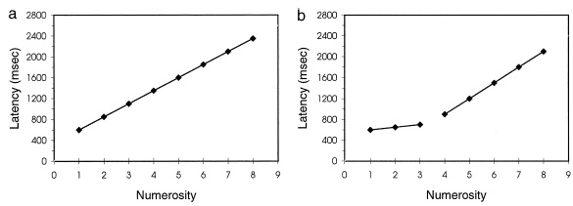
Compare the model to human data
Model
Data
Notes:
a) This is what you would expect from counting – what your model should predict

Slide 92
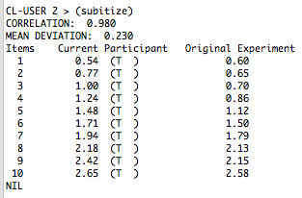
Compare the model to human data
Deviation
Correlation
Model
Data
Notes:
This is what you would expect from counting – what your model should predict
Is the human data
→ The lisp code that comes with he model will write out the data of your model next to the original experiment as well as correlation and deviation values

Slide 93
Root-Mean-Square Deviation
Deviation: (0 – 0) + (2.2 - 4.2) + (2.0 - 3.8) + … = sum(data-model)=
-8.395
Mean Deviation: mean(data-model)=
-1.049375
Mean Square Deviation: mean((data-model)^2)=
1.484098
Root Mean Square Deviation: sqrt(mean((data-model)^2))=
1.218236

Slide 94
Correlation
http://www.tylervigen.com/spurious-correlations

Slide 95
Data Fitting
From now on the assignment models will be compared to human performance
Mostly Response time
Correlation and Mean deviation
Provides a way to compare and judge the models
Not the only way
Plausibility
Generality
Simplicity
Make sure the model does the right thing before trying to tune it with parameters!

Slide 96
Data Fitting
From now on the assignment models will be compared to human performance
Mostly Response time
Correlation and Mean deviation
Provides a way to compare and judge the models
Not the only way
Plausibility
Generality
Simplicity
Make sure the model does the right thing before trying to tune it with parameters!

Slide 97
Data Fitting
From now on the assignment models will be compared to human performance
Mostly Response time
Correlation and Mean deviation
Provides a way to compare and judge the models
Not the only way
Plausibility
Generality
Simplicity
Make sure the model does the right thing before trying to tune it with parameters!

Slide 98
Automatic Parameter Fitting
likelihood
Can work, but be careful – might not be cognitively plausible!
t.max
n

Slide 99
?

Slide 100
Today
Using fMRI to evaluate ACT-R models
ROI analysis
Checking modularity with fMRI
Using ACT-R to analyze fMRI data
Model-based analysis
What is a good model?

Slide 101
Have a good weekend!

